Slide 1

GeoPan
Geolocation Panoramic Picture Application
Kyle Cox
Yoav Peeri
ECE 594BB

Slide 2

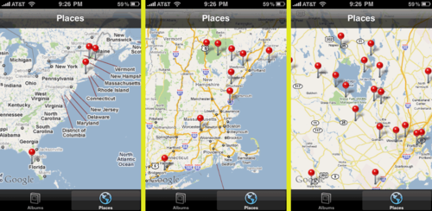
Concept
Why take panoramic pictures?
Camera application to automatically create panoramic images
Easily find pictures based on where you took them
  Location based vs. chronological
  Where, not when
iPhone’s Places

Slide 3
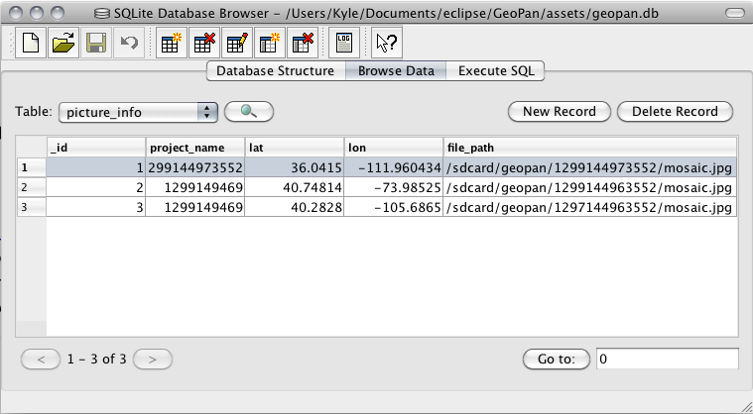
Database Structure
SQLite to store information about each picture taken
  project_name
  latitude
  longitude
  file_path

Slide 4
Database calls
onCreate (create table if not exists)
insertPic
  Inserts row containing the four values it gets passed
selectPic
  Returns all rows of pictures taken
deletePicture
  Deletes a row based on the passed in picture name
loadDemo
  Option to load in a demo database that gets installed with the program

Slide 5
Camera
  On start-up, begins calculating location
  When picture is taken, a new project name is created based on the current system time
  Image is stored into the directory /sdcard/geopan/*project name*/mosaic.jpg
  A new line is inserted into the database

Slide 6
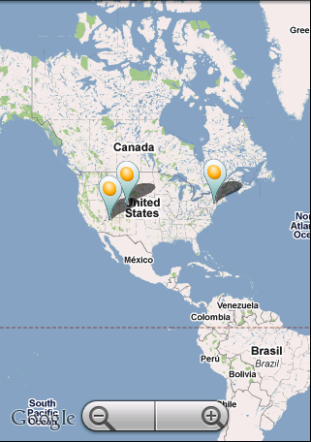
Loading the Map
Starts map zoomed out, centered roughly on current location
Select all pictures from database
Create OverlayItem for each row containing lat, lon, and file_path,
Tapping on a pin starts PictureViewer Intent, and passes the file path.
Checks if pictures exist

Slide 7
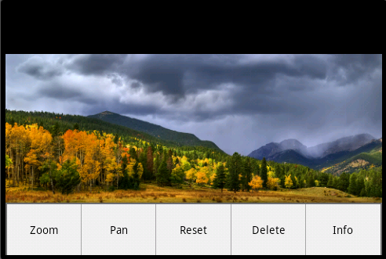
PictureViewer
Using G1 with version 1.6
  No multitouch...
Standard ImageView is relatively limited
Implemented one finger zoom.

Slide 8
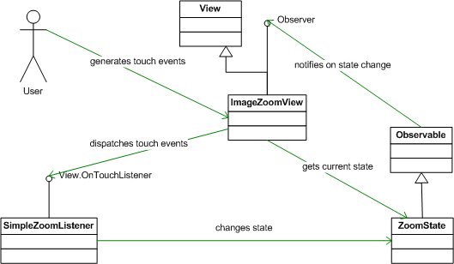
One Finger Zoom
ZoomState: notifies other objects of state change
ImageZoomView: calculates zoom parameters and scales the image
Simple Zoom Listener: Change the zoom or pan values of the state when the user touches the screen

Slide 9
PictureViewer Options
Loads in landscape mode
Zoom the image
Pan the image
Reset the image to fit in the screen
Delete the picture from SD card and table
Info about when picture was taken

